Slide 2
CLIENT:
GUARDS
STUDENTS
DISCIPLINES OFFICE

Slide 3
GUARD NEEDS:
A way to issue violations faster.
To be able to check student credentials faster.
A way to issue violations without using paper.
A way to issue violations in a legible form.

Slide 4
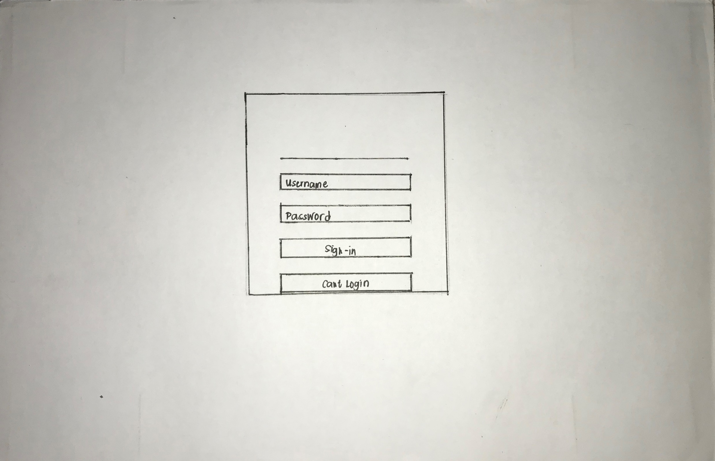
GUARDS

Slide 5
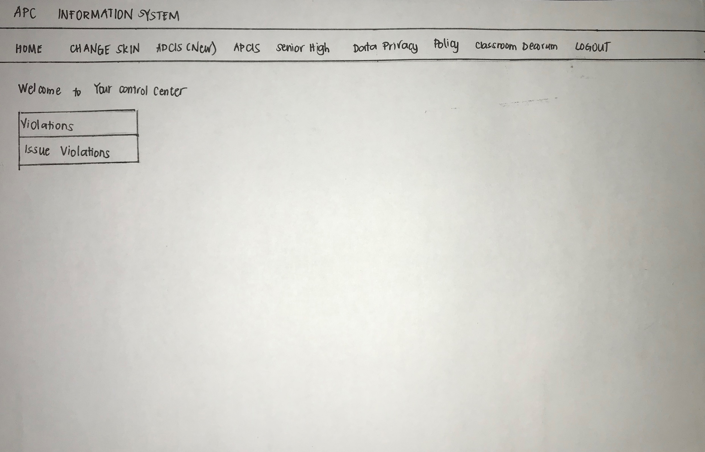
GUARDS

Slide 6
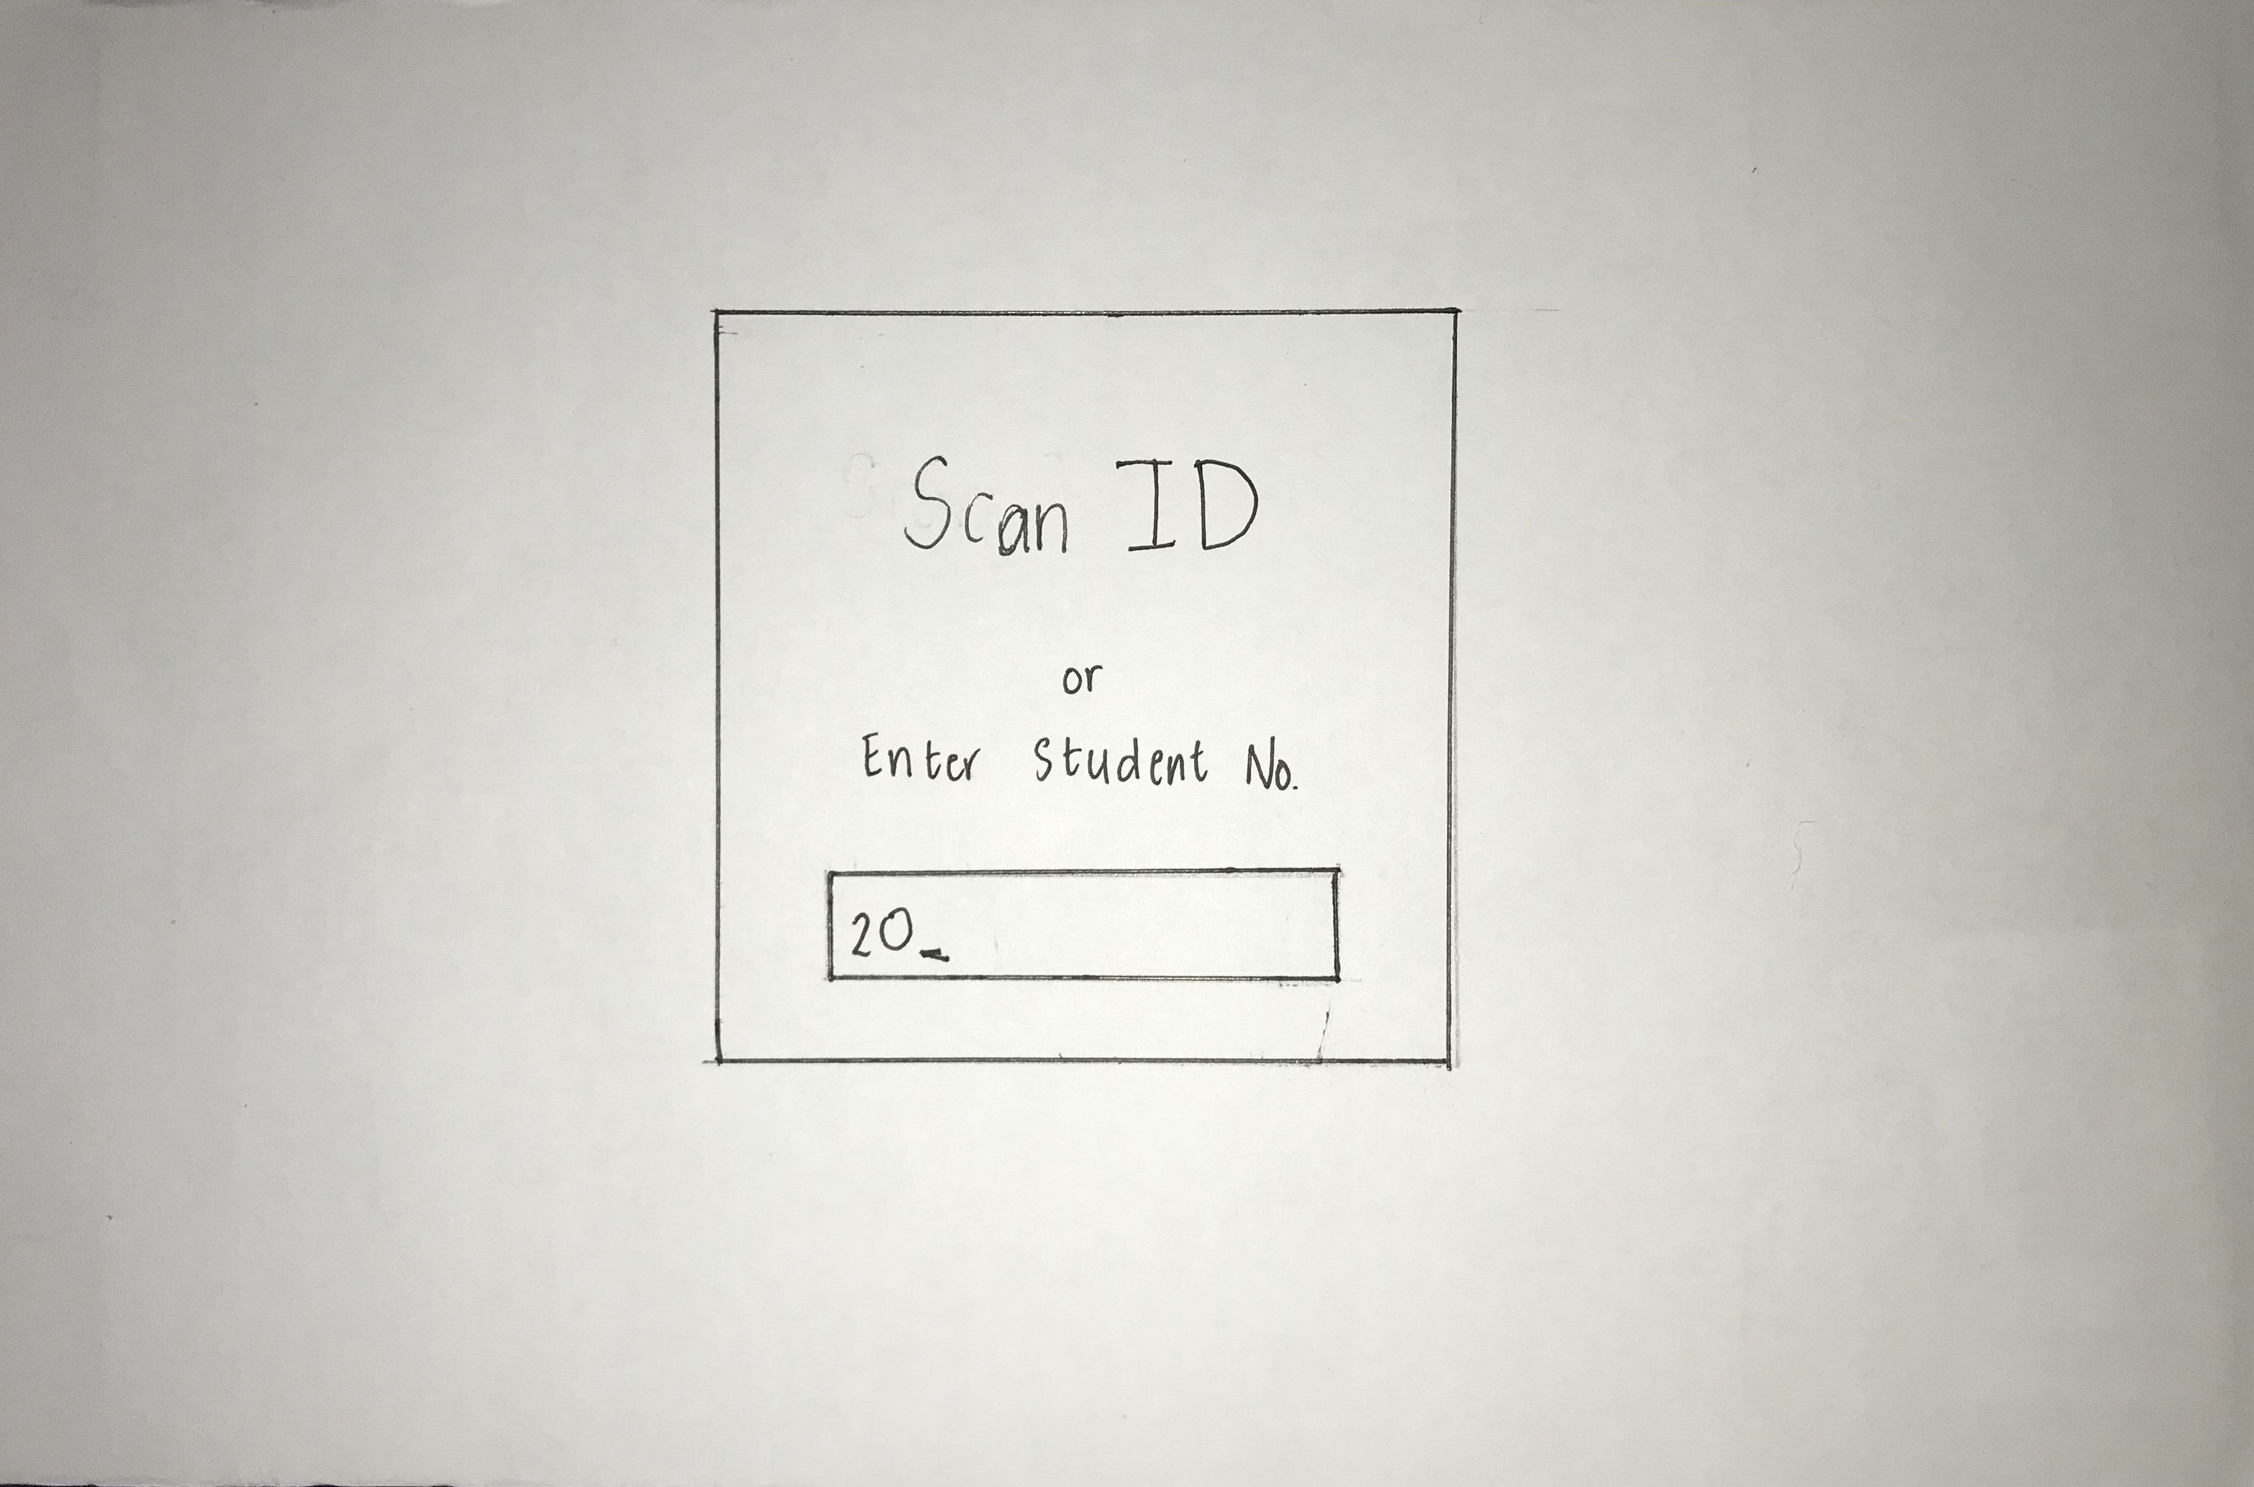
GUARDS

Slide 7
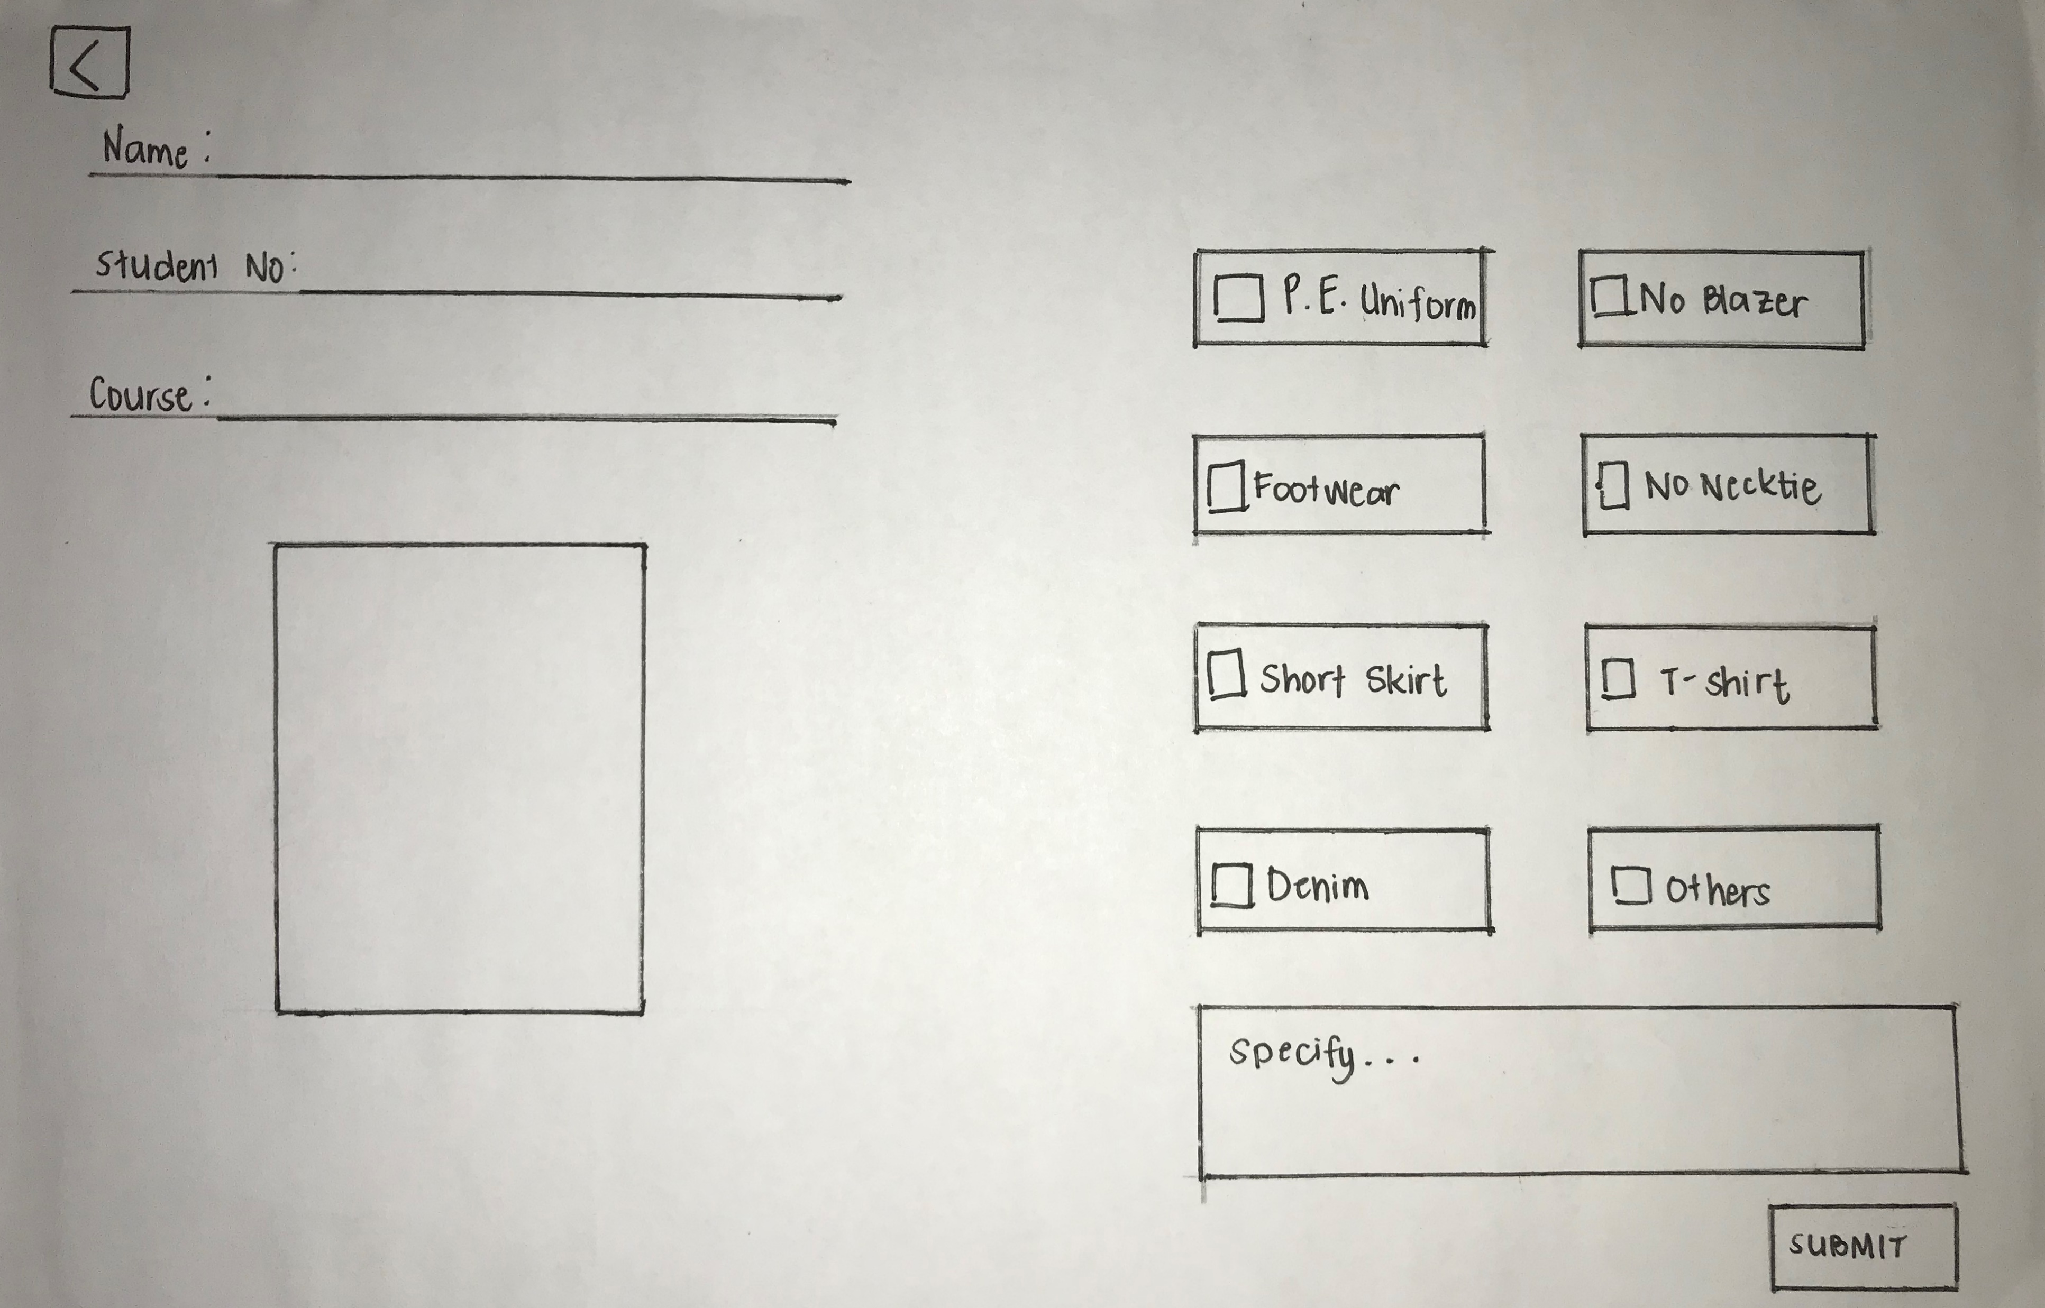
GUARDS

Slide 8
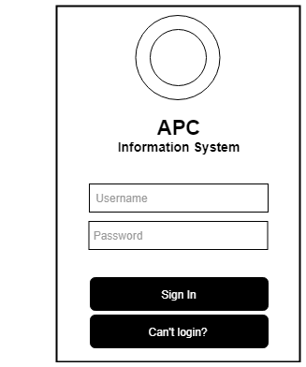
GUARDS

Slide 9
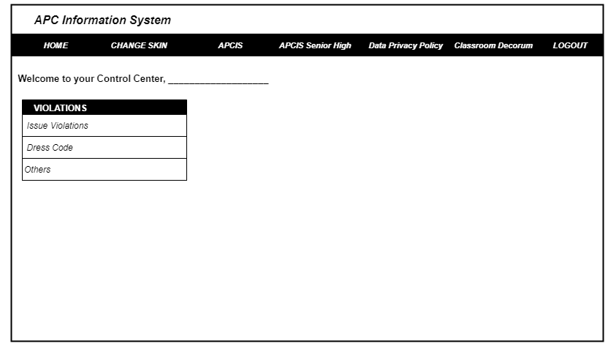
GUARDS

Slide 10
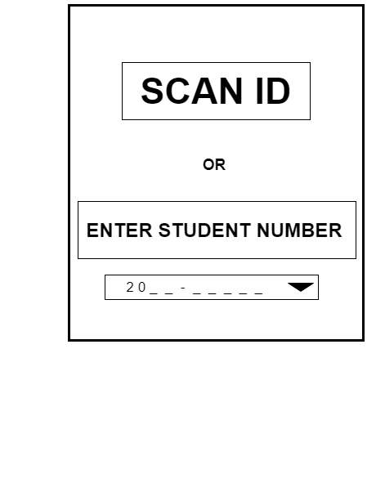
GUARDS

Slide 11
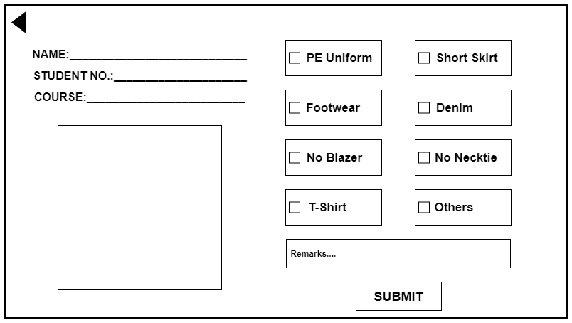
GUARDS

Slide 12
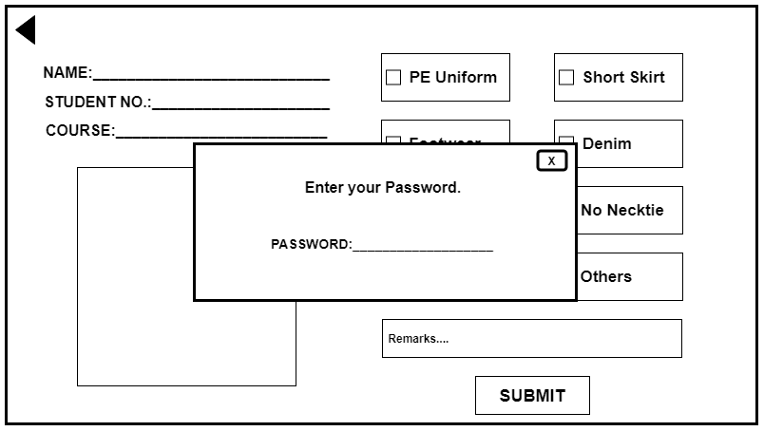
GUARDS

Slide 13
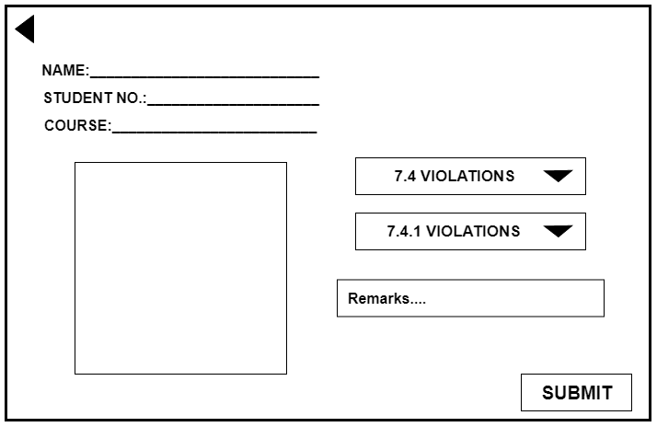
GUARDS

Slide 14
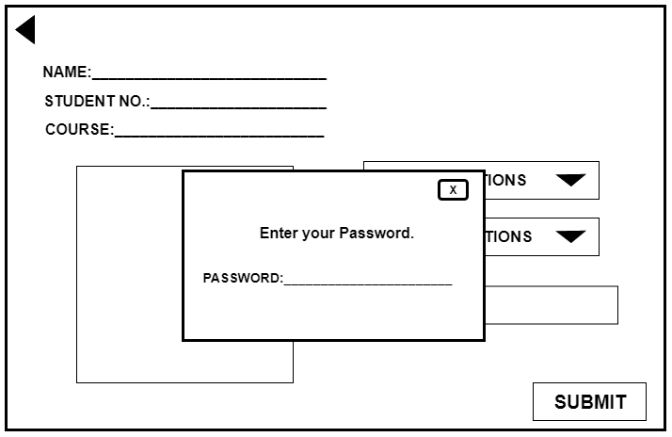
GUARDS

Slide 15
STUDENT NEEDS:
A way to monitor their violations.
A way to cancel violations.

Slide 16
STUDENTS:

Slide 17
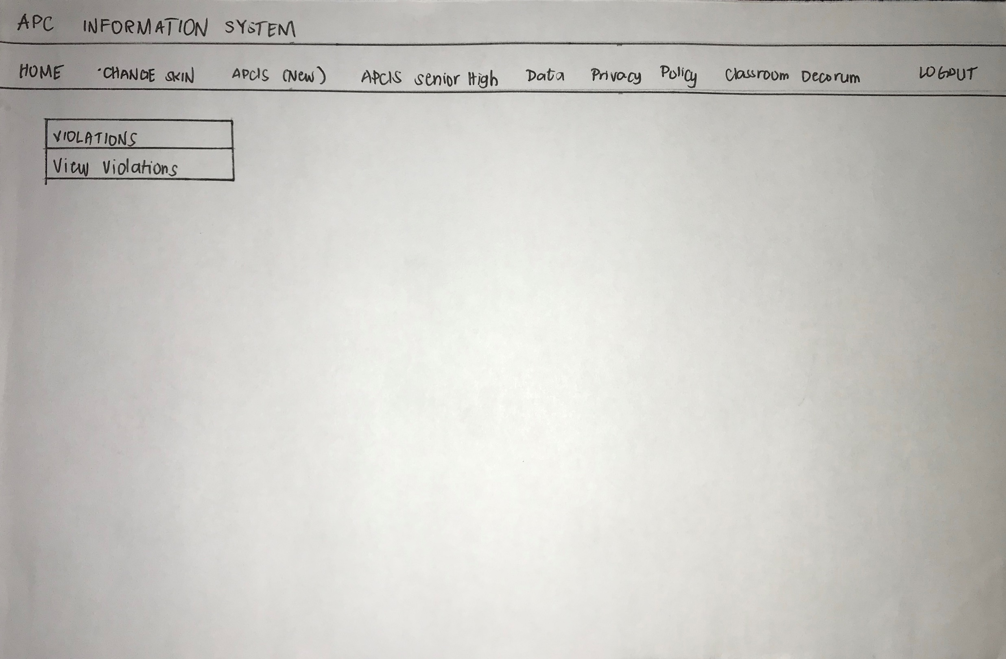
STUDENTS:

Slide 18
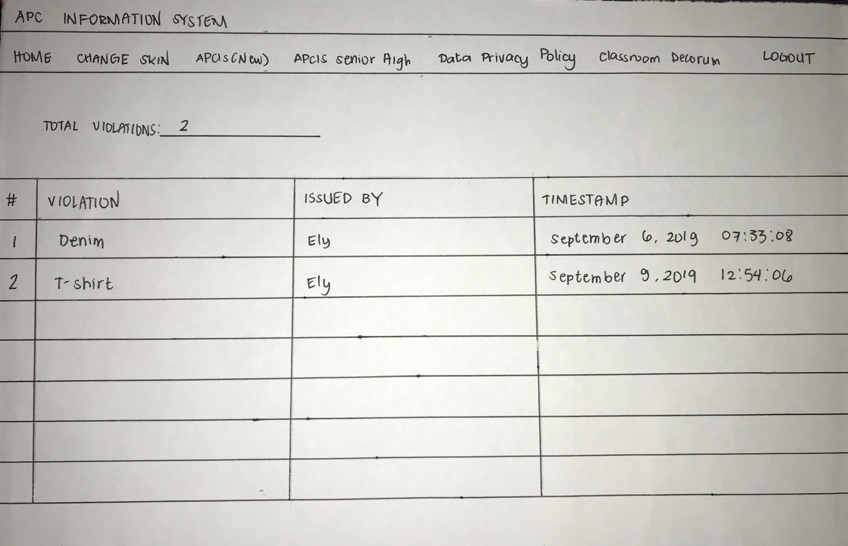
STUDENTS:

Slide 19
STUDENTS:

Slide 20
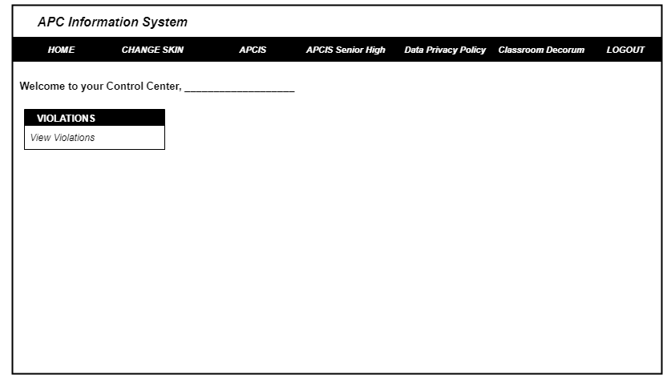
STUDENTS:

Slide 21
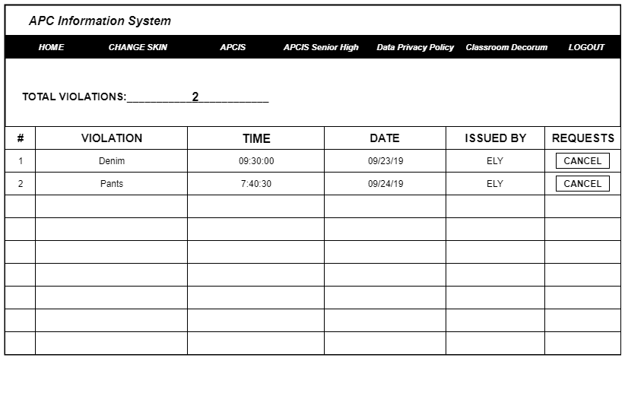
STUDENTS:

Slide 22
D.O NEEDS:
A way to monitor student violations easily.
A way to cancel violations without searching for violation paper
issued.

Slide 23
DO:

Slide 24
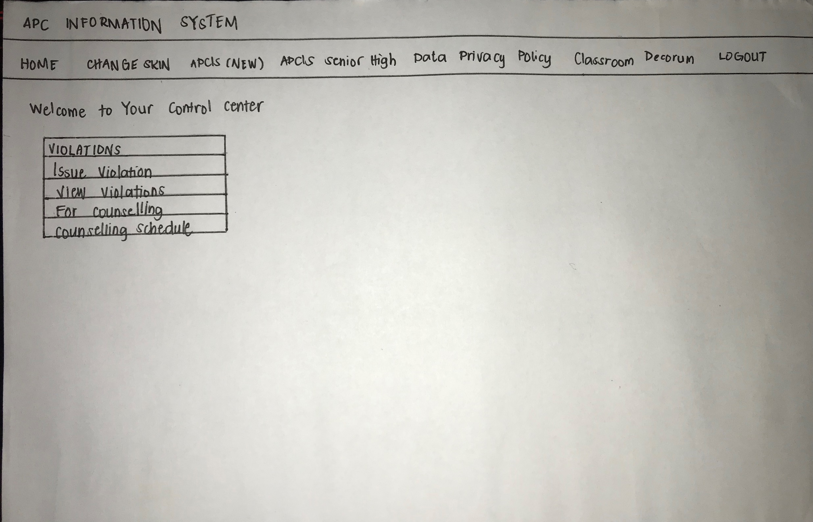
DO:

Slide 25
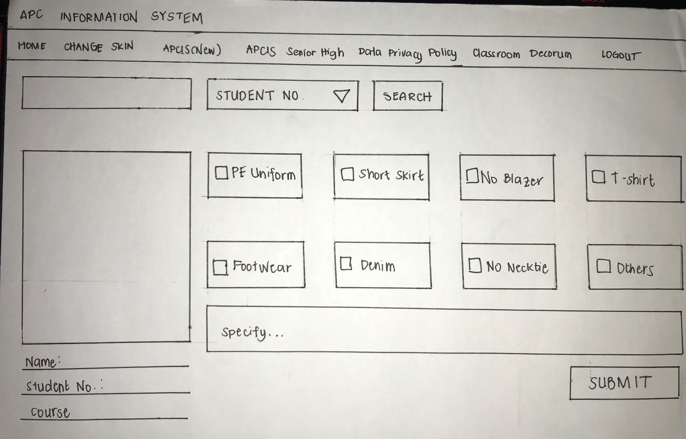
DO:

Slide 26
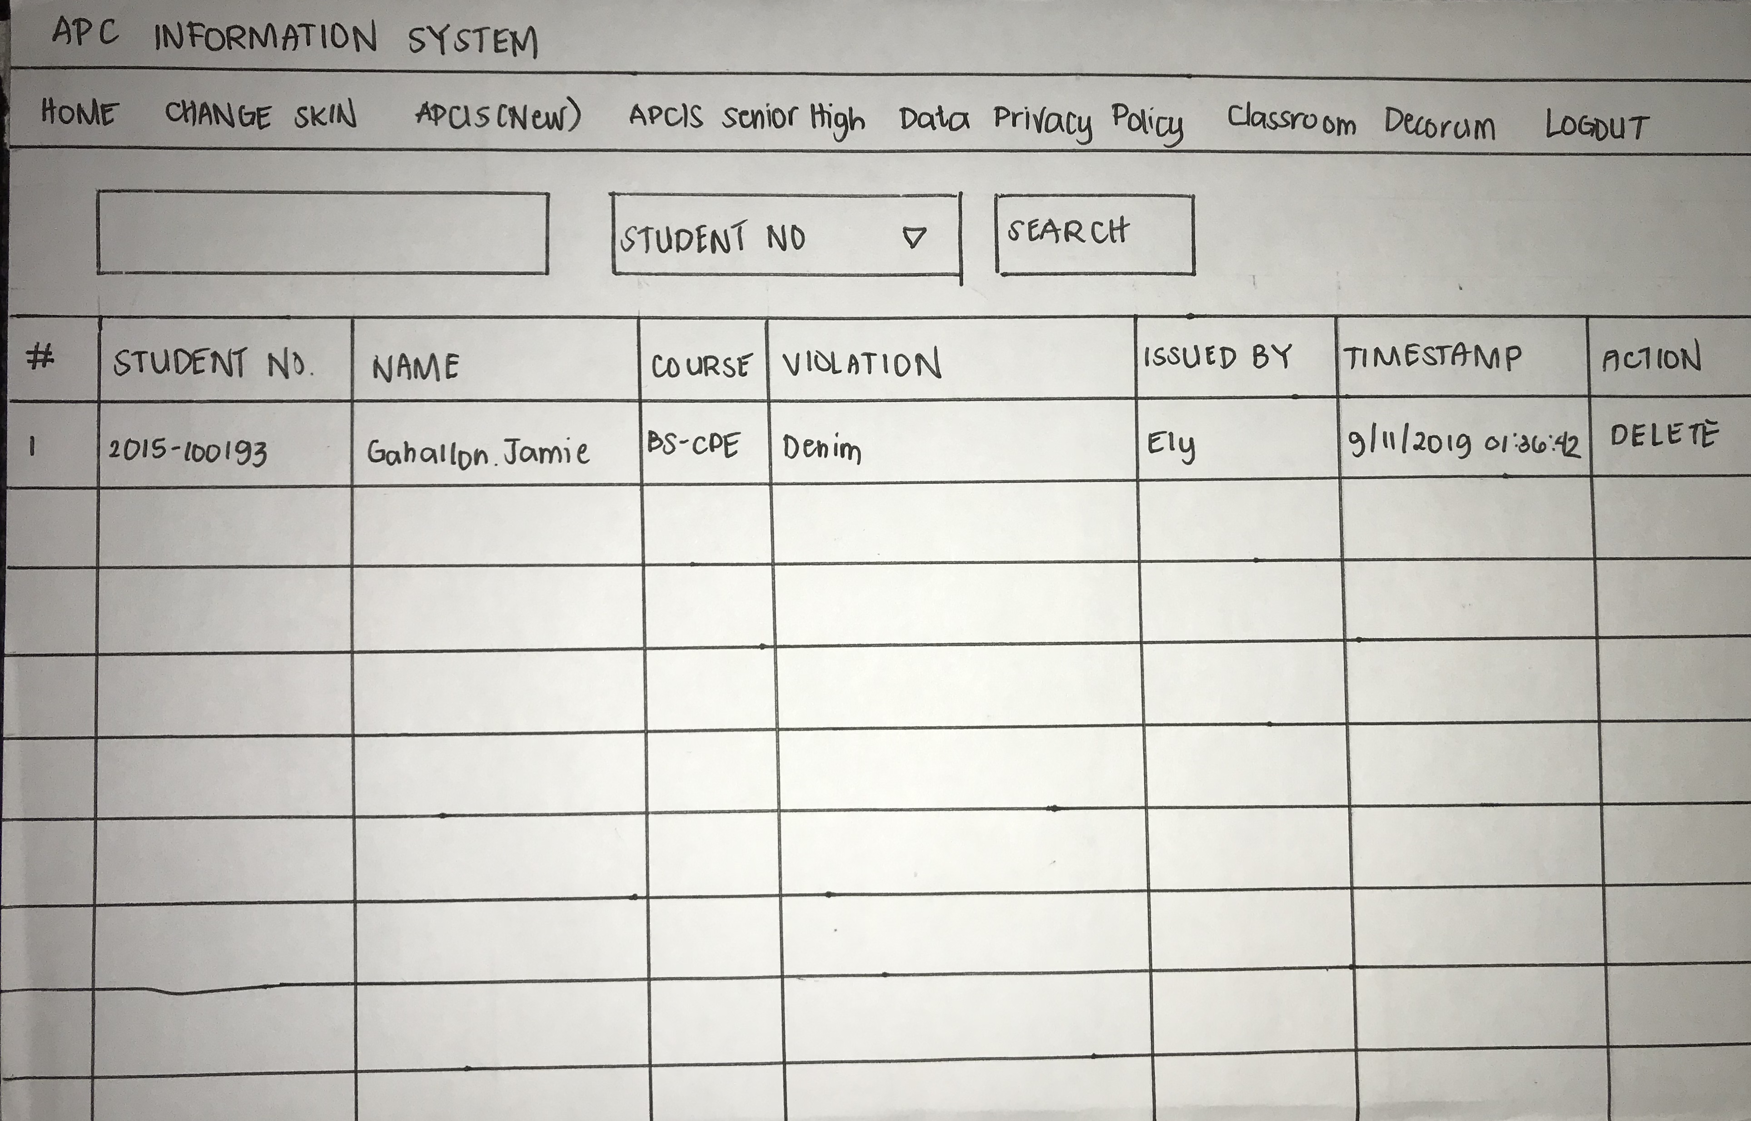
DO:

Slide 27
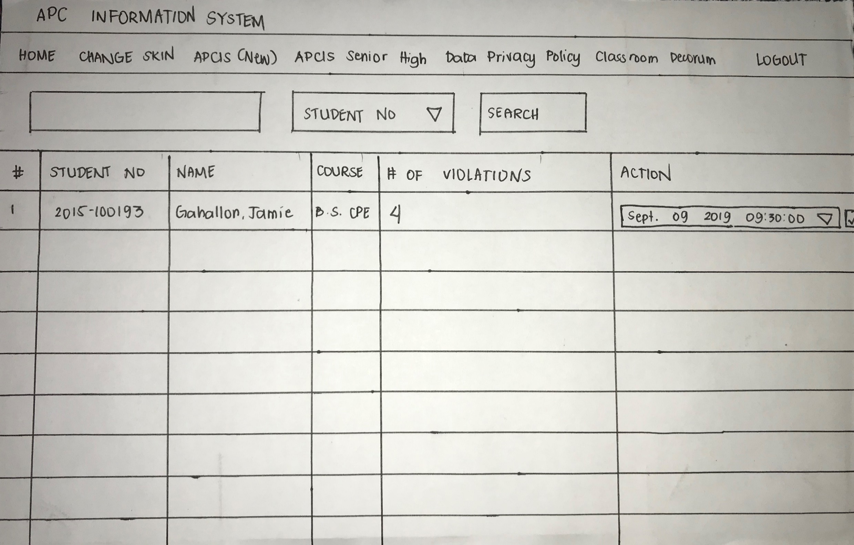
DO:

Slide 28
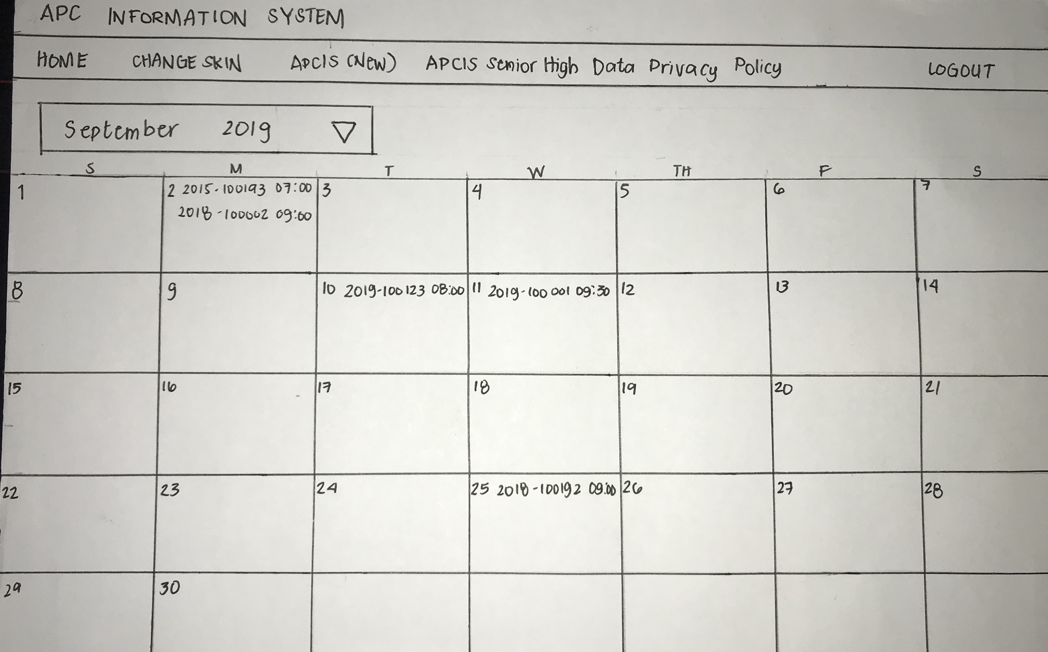
DO:

Slide 29
DO:

Slide 30
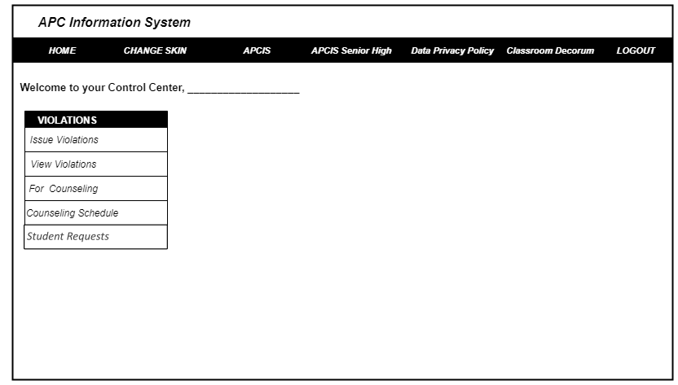
DO:

Slide 31
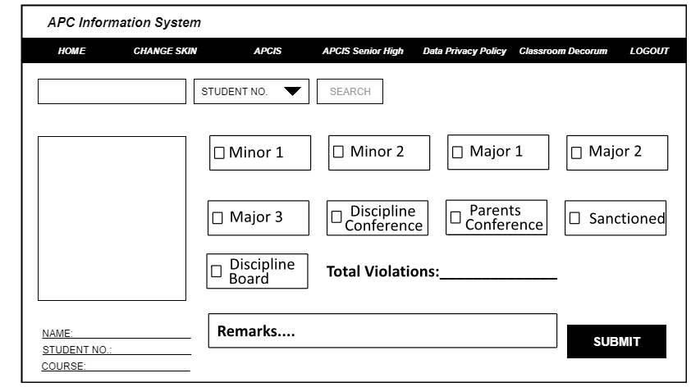
DO:

Slide 32
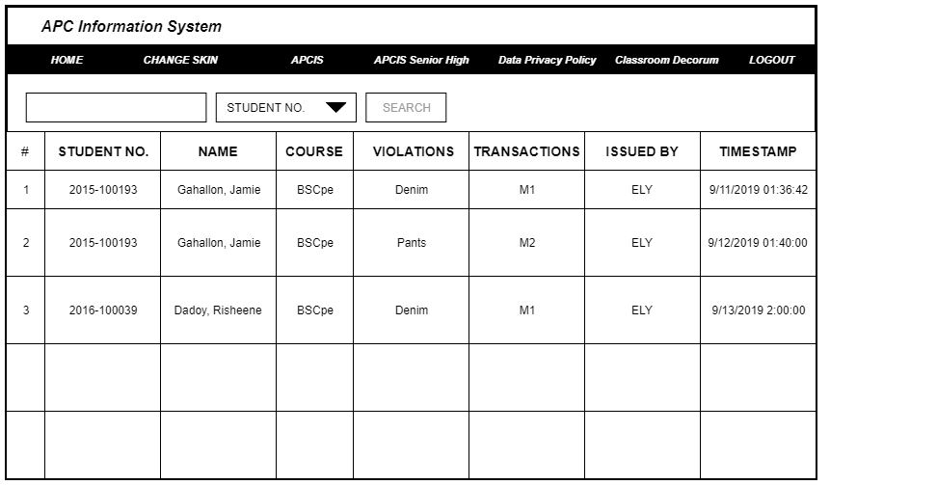
DO:

Slide 33
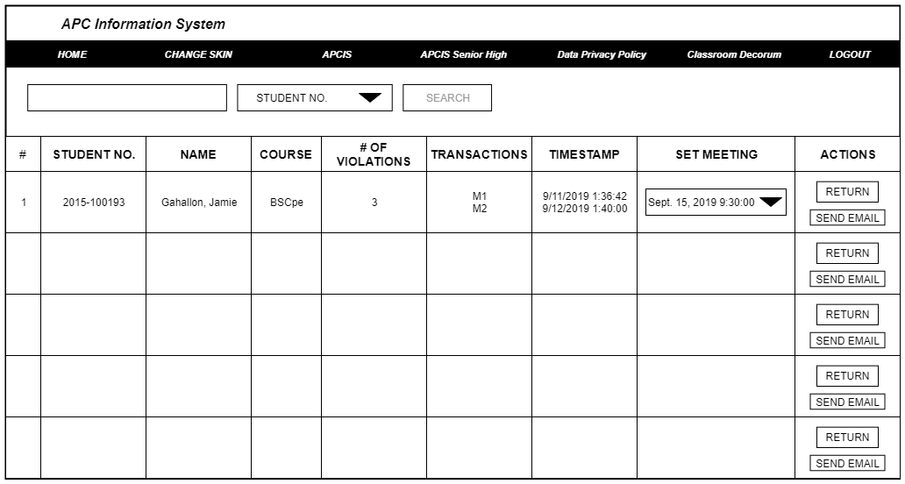
DO:

Slide 34
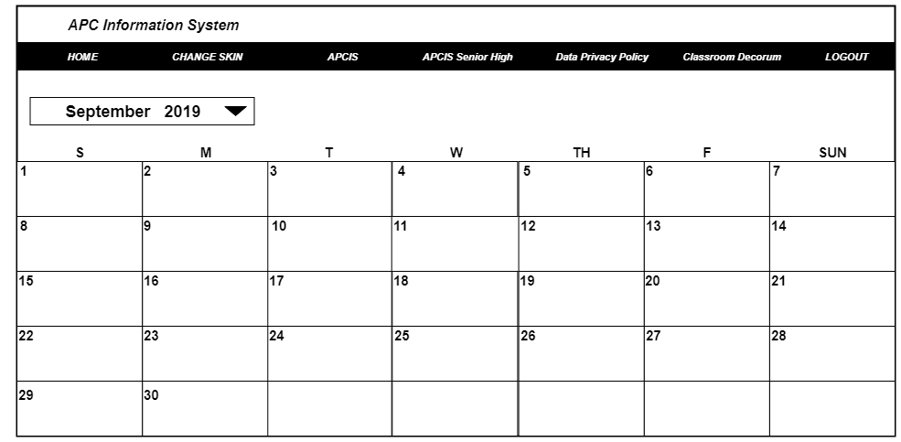
DO:

Slide 35
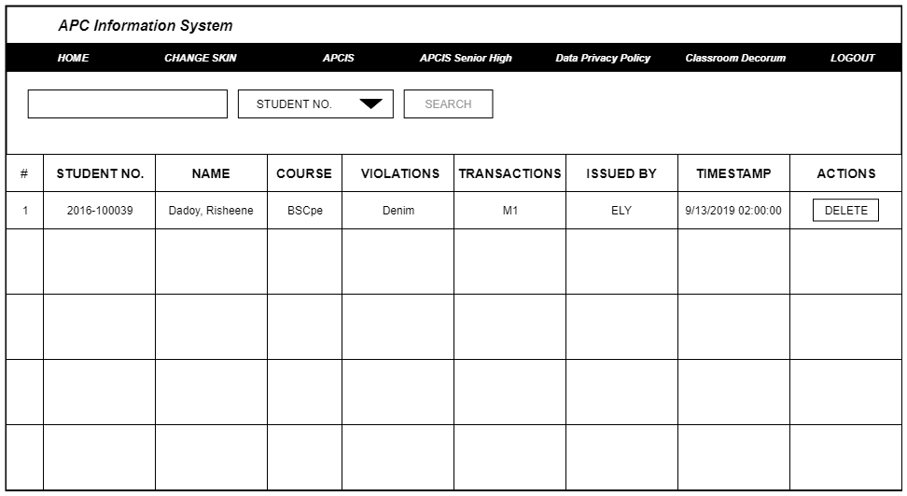
DO:

Slide 36
POINT OF VIEW:
Issuing violations shouldn’t be a tedious task for security guards.
Violations can be issued electronically, especially in an IT enabled school.
By using NFCs in student ID, student verification can be quick and easy.
Students and the Disciplines Office can use FLAVIO to track their violations.

Slide 37
INTERVIEW VIDEO LINKS:
https://youtu.be/Oloub6OI2So
https://youtu.be/zJQytN80-2s
https://youtu.be/2cXiNvAngc4
https://youtu.be/yAvW83x2-uU
https://youtu.be/KdRKFIk-W_0
https://youtu.be/7wlJNRfyyoM
https://www.youtube.com/watch?feature=youtu.be&v=4bXH9bmzdno&fbclid=IwAR1rGkJwMVQZlIeraPLvnD09WUJQNiprz0qcmLqCMURiH2uggPKcODeBjcs&app=desktop

